Slide 1

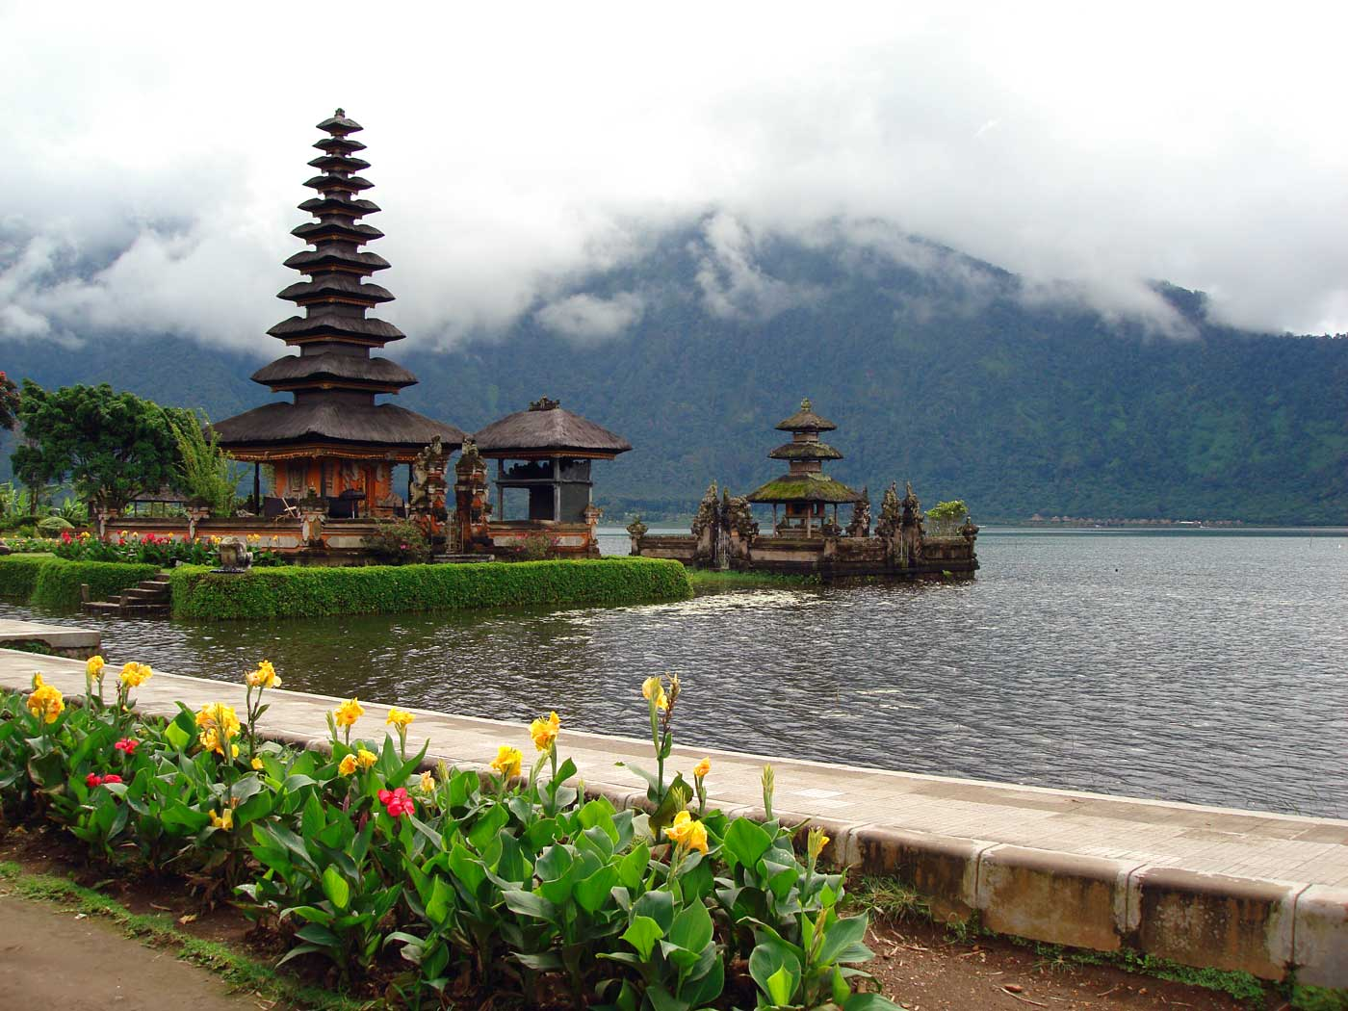
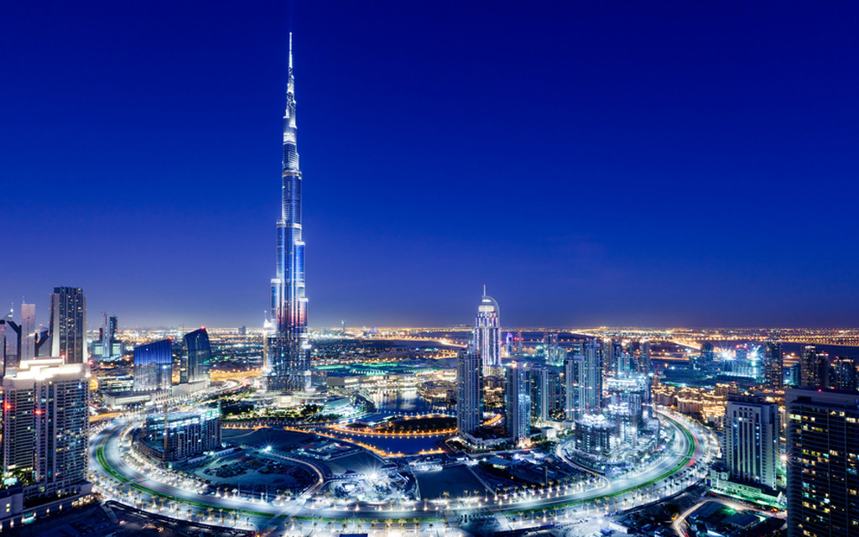
Places you must Visit
Home | Japan | Bali | Dubai | About us / Contact Us
Japan
Bali
Dubai
This Photo by Unknown Author is licensed under CC BY-SA-NC
This Photo by Unknown Author is licensed under CC BY-NC-ND
This Photo by Unknown Author is licensed under CC BY-SA
Footer

Slide 2


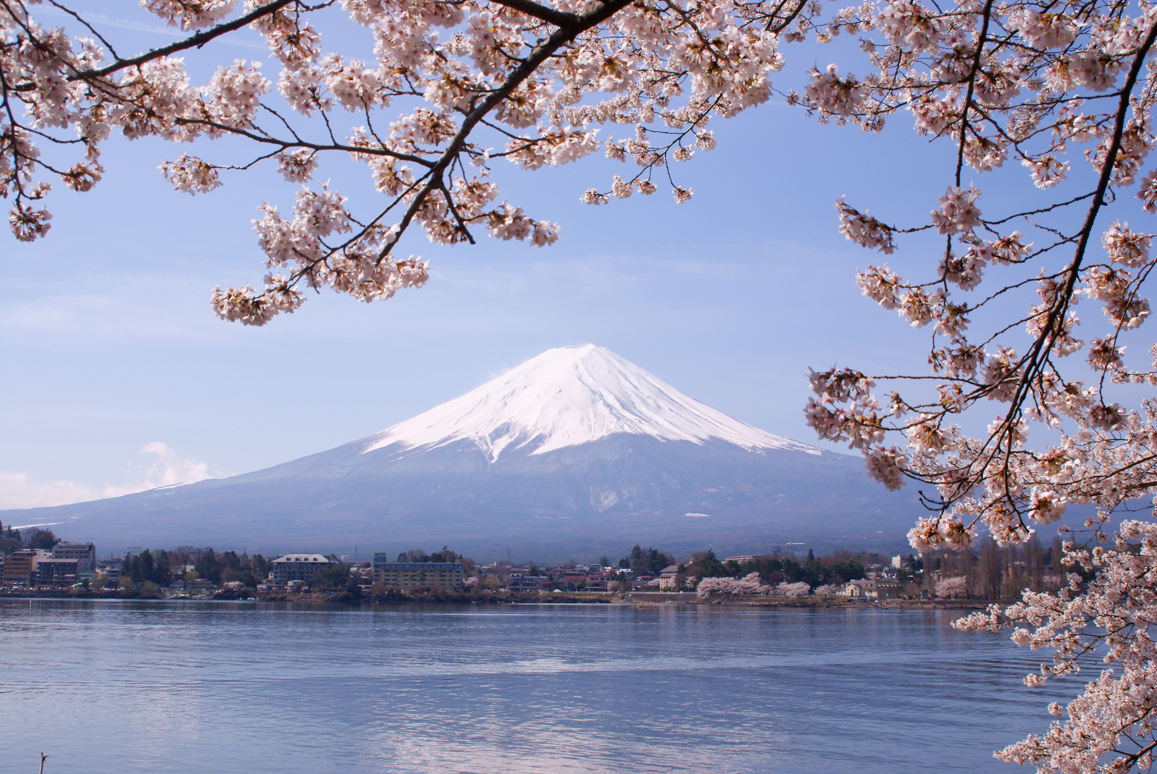
Japan
Home | Japan | Bali | Dubai | About us / Contact Us
The Food
The Attractions
Natures Beauty
Japan is known for their fresh fish normally served with white rice. They are also famous for their sushi and ramen. The delicious food is one of the main attractions for tourist.
The Tokyo tower was built in 1958 and still attracts tourist every year. However, they just built Nintendo World which will attract tourist like crazy once the pandemic dies down.
Mount Fuji and the cheery blossom trees are enough to convince people to travel to Japan. They also have many famous rivers such as Kamikochi highland river valley
Footer

Slide 3
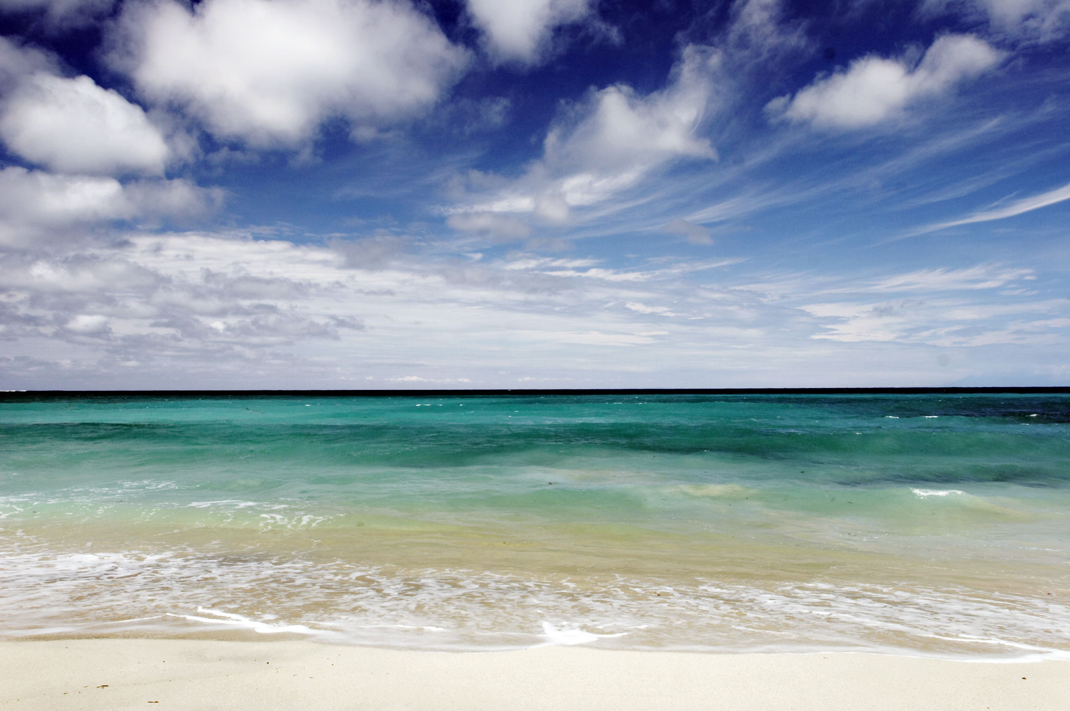
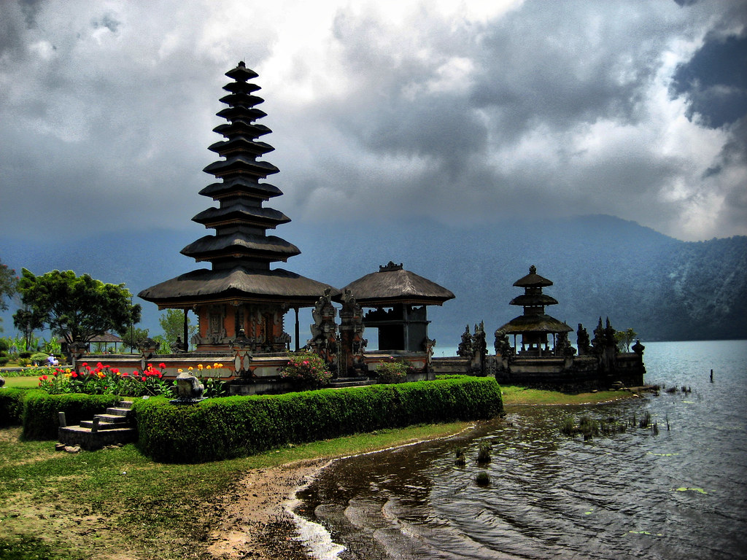
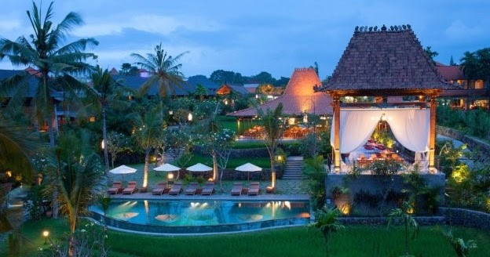
Bali
Home | Japan | Bali | Dubai | About us / Contact Us
Beaches
Temples
Island of the Gods
Bali is known for their exotic beaches that include black-sand beaches and private beaches for travelers. These beaches even offer Scooba diving with the chance of seeing exotic animals.
The number of temples located in Bali were created for religion purposes. Which makes them a must while visiting. It allows you to experience an unique experience as if you were the one living there.
This name was given due to religion reasons and the tropical paradise it offers. The culture of this island is what they care for most. They celebrate with festivals and The day of silence every year.
Footer

Slide 4
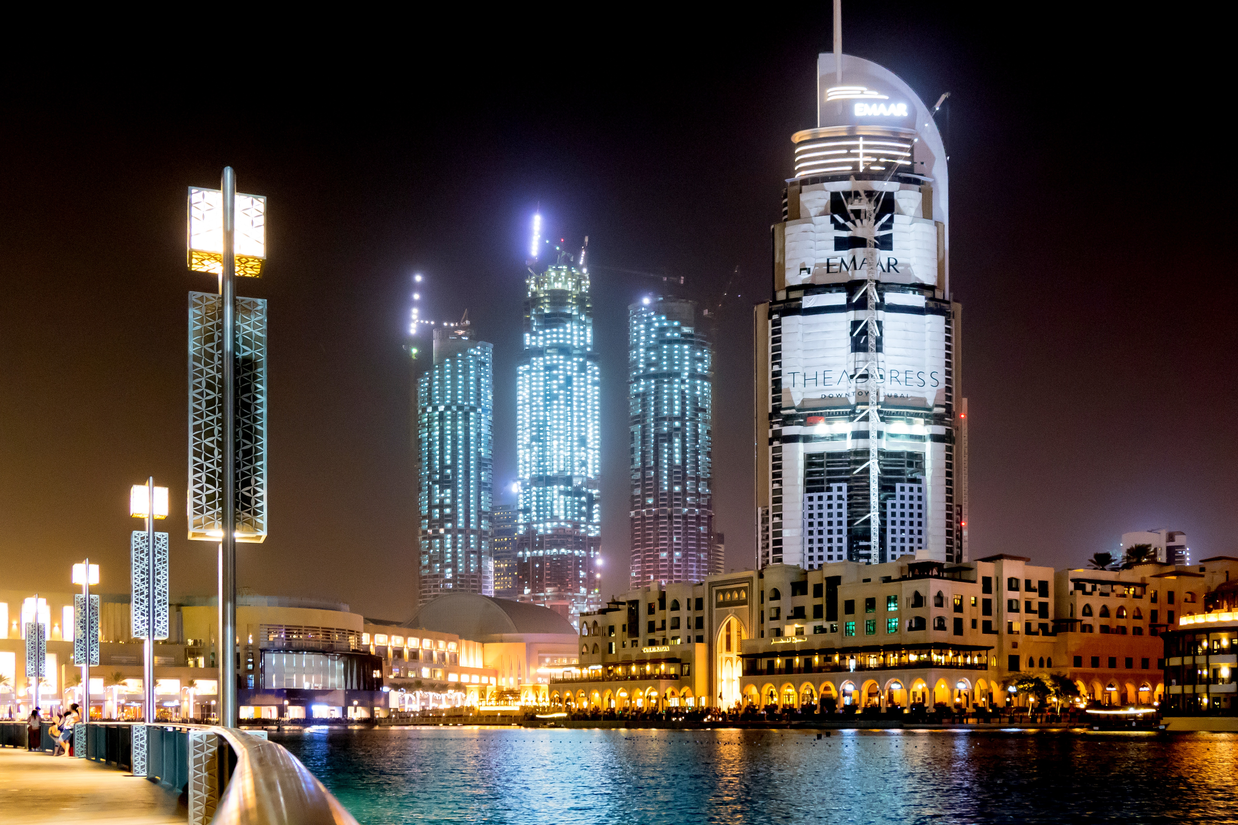

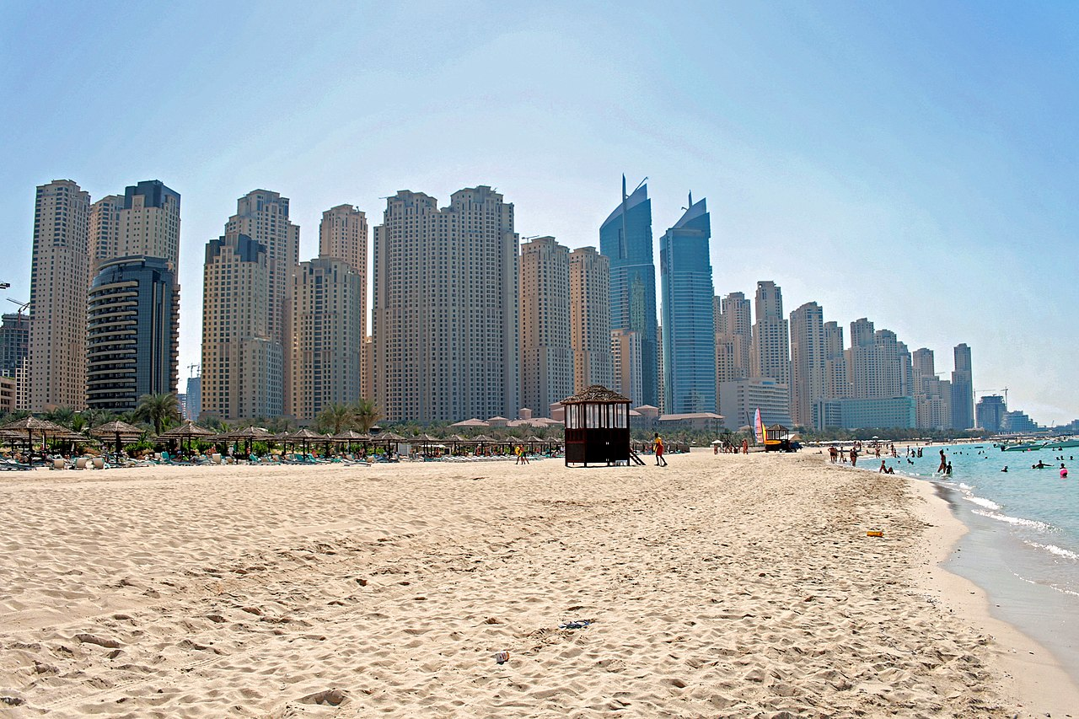
Dubai
Home | Japan | Bali | Dubai | About us / Contact Us
Futurist Architecture
Unique Activities
Beaches and Weather
Dubai is home to the tallest building in the world. The Burj Khalifa is surrounded by other unique and tall buildings that have an amazing sight to see at night.
There are so many unique activities to do that you won’t find anywhere else. Dubai has insane shopping malls that include aquariums and ski slops. Did I mention you can eat a delicious dinner while floating up in the sky?
If you enjoy warm weather, you would love to visit here anytime of the year. Dubai is normally warm all year which makes it perfect for their beaches. The beaches have so much variety. There are public, private, and hotel guest only beaches.
Footer

Slide 5
About Us / Contact Us
Home | Japan | Bali | Dubai | About Us / Contact Us
We love suggesting new places that you should consider visiting for vacations! We update our website monthly to suggest new places for everyone who keeps up with our page.
Contact us either by phone or email!
Phone: (555) 398-3715
Email: ExploreNewPlaces@gmail.com

